Slide 1
DESIGN AND TESTING OF A LOCALLY MADE
REMOTELY OPERATED VEHICLE
DENNIS SAMMY ENM241-0117/2019
PEGGYOLANDA NYAMBURA ENM241-0118/2019
PROJECT SUPERVISOR DR. ELIJAH MUNYAO

Slide 2
Objectives
1. Design the various components of the ROV.
2. Test the ROV on attainment of a design depth of 1m while maintaining stability and water tightness.
3. Achieve maneuverable controls on the ROV’s main axes

Slide 3
Methodology
Material selection
Key components of focus in material selection:
Frame of the ROV
Sealing compartment
End caps
The design considerations of the ROV include:
Withstand pressure at the designed depth.
Cost effective.
Light in weight.
Resistive to water corrosion.
Easily machinable
Easily available.
Sturdy and robust.
Low magnetic properties.
The suggested ROV frame materials include:
Aluminum
Acrylic
Stainless steel
Unplasticized PVC

Slide 4
Generating the model of the ROV.
The model development study is carried out on an existing ROV.
A FEA is conducted of the model with each of the selected material.
FEA is conducted at 3 depths of 10m, 50m, and 100m with pressures of 101043 Pa, 505215 Pa, and 1,010,430 Pa respectively.
Design considerations for the frame include:
Simplicity and rigidity
Symmetry in thrusters’ distribution.
The model below is adopted. It is then taken through a series of Fine Element Analysis.
Sealing compartment and end cap
A clear acrylic plexiglass is used. It can withstand pressure at the designed depth.
End caps are machined using Teflon due to its low friction, thermal resistance, and corrosion resistance.
A nylon ring is machined to press the transparent dome against the front cap once sealed with silicone to make it watertight.

Slide 5
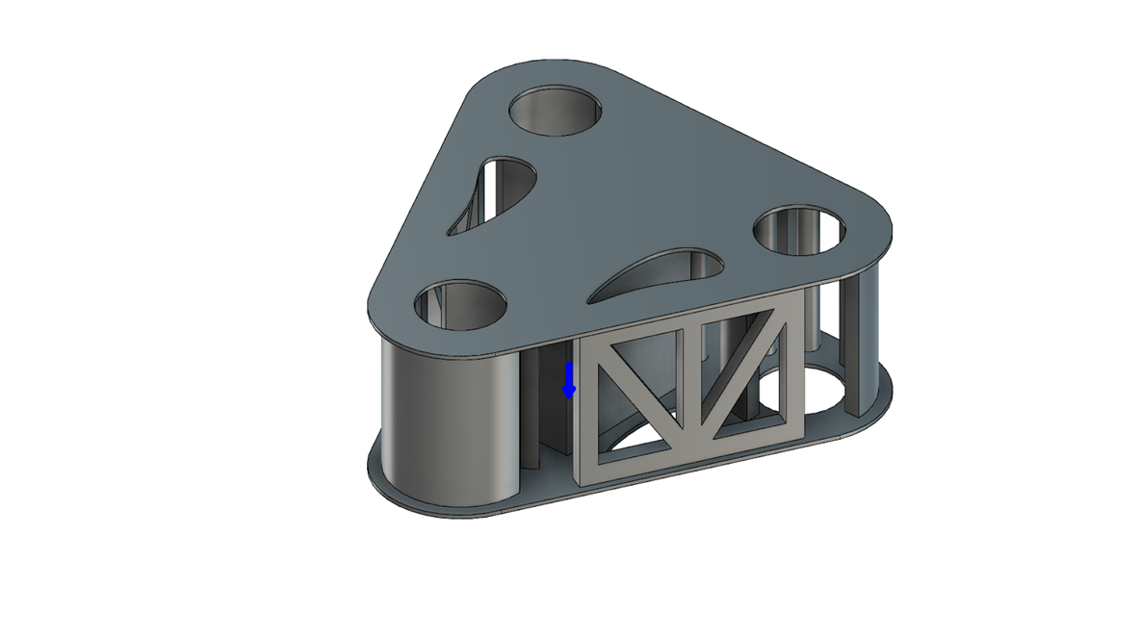
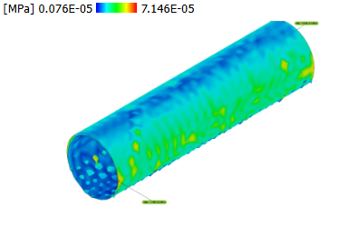

Slide 6
Propulsion system
It consists of motors and propellers- a combination called a thruster.
It is to have a high thrust to physical size and power input ratios.
Considerations when selecting a propeller:
Performance – Ducted propellers move more liquid and increase efficiency
Speed -
Weight – Should be light in weight
Overall size of the ROV- Small diameter propellers help avoid collision with other components of the ROV
Due to weight and cost restrictions, nylon plastic propellers are selected to ensure the best performance to cost ratio.
Thruster design
A duct is designed around the propeller to minimize losses at the propeller blades.
It is designed with an aerodynamic structure to increase the efficiency of the design.
The diameter of the propeller is chosen to be bigger than the motor diameter for :
Enhanced thrust efficiency
Reduced cavitation
Lower power consumption
Improved control and stability
Optimized flow characteristics and hydrodynamic performance
Each thruster is to be controlled using an Electronic Speed Controller.

Slide 7
Thruster configuration
The ROV is designed with five thrusters. It is with the intent to achieve 6 degrees of freedom.
Two thrusters are placed on the back of the ROV equidistant from the center of momentum in the X-direction to minimize rotation.
The final three thrusters are placed on the top of ROV which provides the motion in the Z-direction.
Weight and Displacement of the ROV

